Slide 1




APPLIED DATA SCIENCE CAPSTONE PROJECT
by Nhlanhla Sanele Dludla

Slide 2


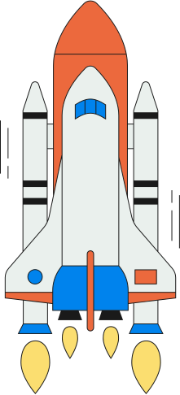

Outline
Executive summary
Introduction
Methodology
Results
Conclusion

Slide 3

Executive summary
Conventional space exploration is expensive. To cut costs associated with space travel, SpaceX reuses their first stage. In the bid to cut launch costs, in this capstone project we aim to predict whether the first stage of Falcon 9 will land successfully or not on landing pads for reuse. To achieve this, data will be collected cleaned and formatted. In addition exploratory and predictive analyses will be performed. Results will be presented in graph format.

Slide 4
Introduction
Conventional space exploration is expensive. The typical costs to launch space crafts costs up to $165 Millon. To cut costs associated with space travel, SpaceX reuses their first stage. In the bid to cut launch costs, in this capstone project we aim to predict whether the first stage of Falcon 9 will land successfully or not on landing pads for reuse. To achieve this, data will be collected cleaned and formatted. In addition, exploratory and predictive analyses will be performed. Results will be presented in graph format.

Slide 5




Methodology
Data collection and processing.
Data analyses
Data visualization
Machine learning and prediction

Slide 6
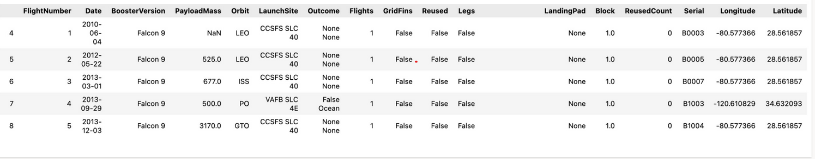
Data collection: API + Data wrangling
“https://api.spacexdata.com/v4/launches/past” was used to access SpaceX data.
Collected data was decoded into a JSON file and IDs were assigned to specific columns.
The dataframe was then filtered to include only Falcon 9 launches.
data_falcon9.isnull().sum() was used to identify missing values.
Using data_falcon9['PayloadMass'] = data_falcon9['PayloadMass'].replace(np.nan, payloadmass_mean) missing values were replaced with mean values.

Slide 7
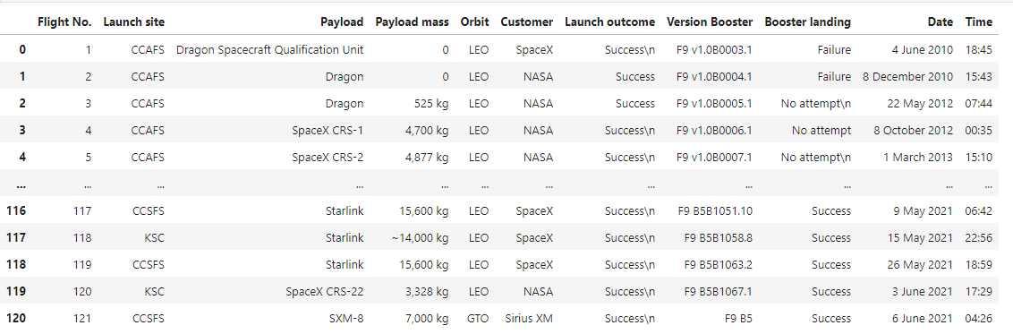
Data collection: Webscrapping
Using BeautifulSoup Falcon 9 launch table records were extracted from Wikipedia.
HTML tables were parsed and a dataframe was created.

Slide 8
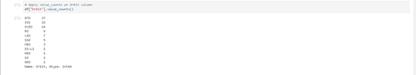
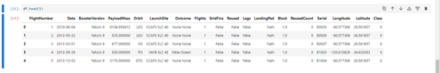
Data analyses: Exploratory
Using Pandas and Numpy, A wrangled dataset was loaded and information on the number of launches, orbit occurances, and missions outcomes was collected.

Slide 9
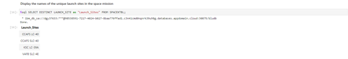
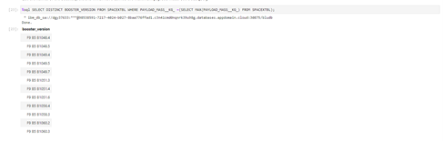
Data analyses: Exploratory
Using SQL, previously collected and wrangled data was queried to obtain information: 1) on the unique launch sites 2)launch sites that begin with CCA 3) total payload mass carried by boosters launched by NASA 4) average payload mass carried by booster F9 V1.1. 5) the date of the first successful landing on a ground pad 6) total number of successful and failure missions etc.

Slide 10
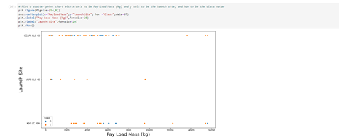
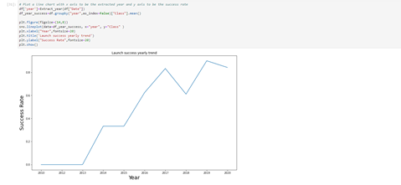
Data visualization: Exploratory
To understand relationships between variables of interest, using matplotlib and seaborn, collected and wrangled data was visualized using bar charts, line graphs and scatterplots.
To visualize and to mark launch sites where succssful/ unsuccessful launches took place Folium was used to create interactive maps.

Slide 11
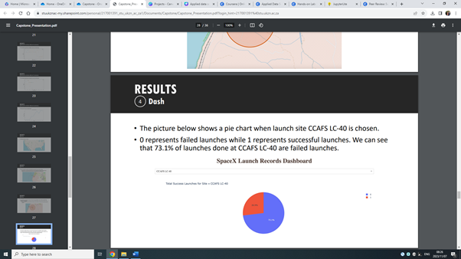
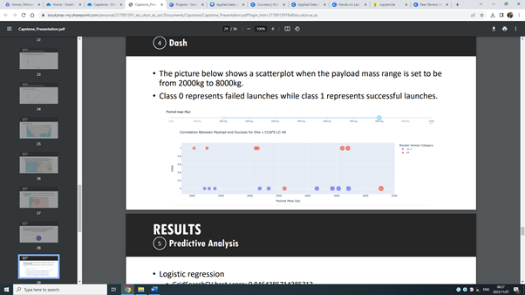
Data visualization: Dash
Using dash, an interactive pie and scatterplot chart was created to vizualize the total success launches from each site and the correlation between payloadmass and mission outcome.

Slide 12
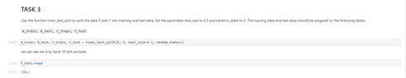
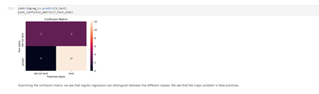
Machine learning
Using functions from scikit-learn, machine learning models were built. This was achieved by 1) standardizing the data 2) splitting the data into a train and test test 3) fitting built models on the training set 4) evaluating model accuracy based on the confusion matrix.

Slide 13

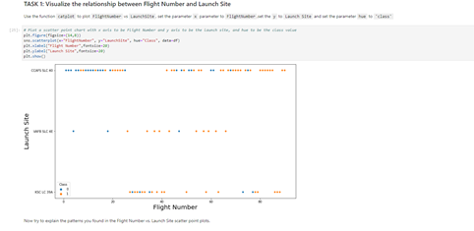
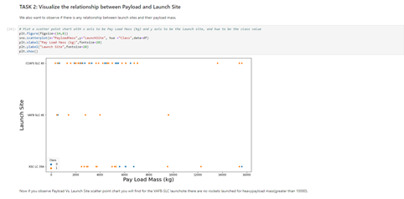
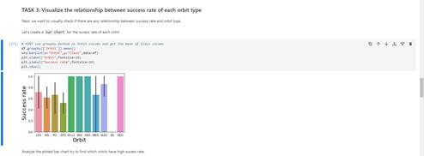



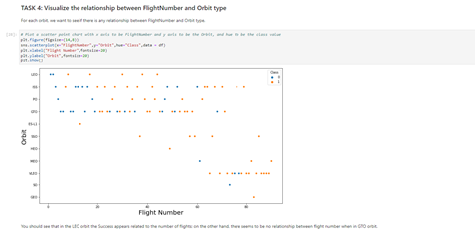
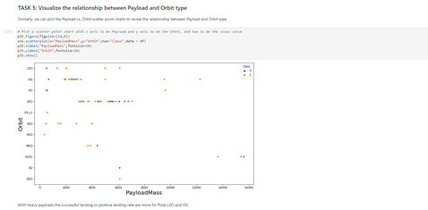
Results
EDA with visualization

Slide 14
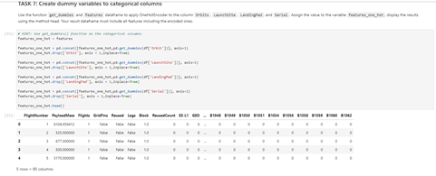
Results
EDA with visualization

Slide 15
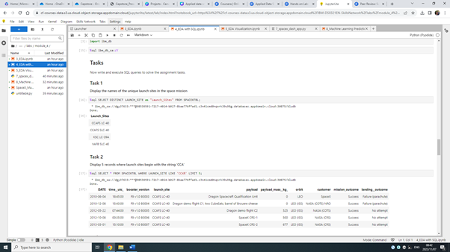
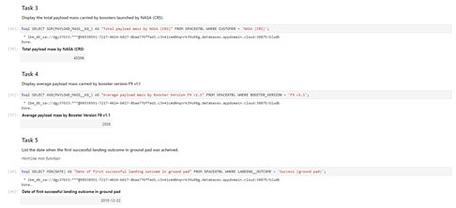
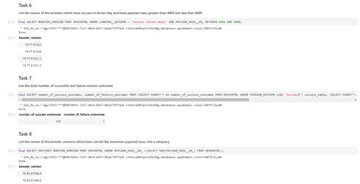
Results
EDA with SQL

Slide 16
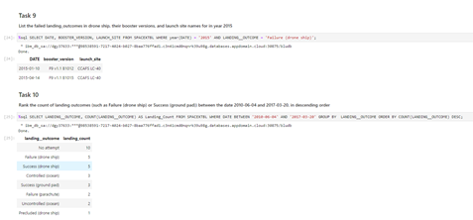
Results
EDA with SQL

Slide 17
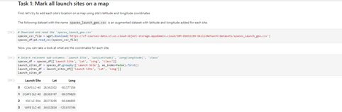
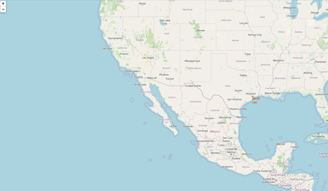
Results
Interactive maps with folium

Slide 18
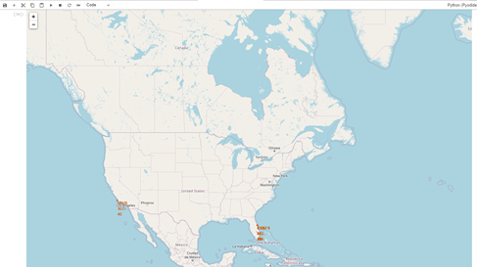
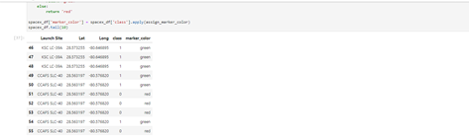
Results
Interactive maps with folium

Slide 19
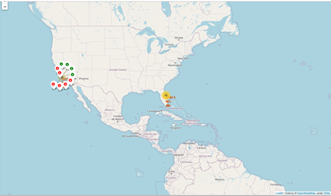
Results
Interactive maps with folium

Slide 20
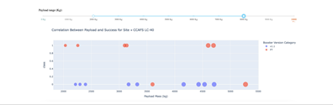
Results
Dashboard

Slide 21
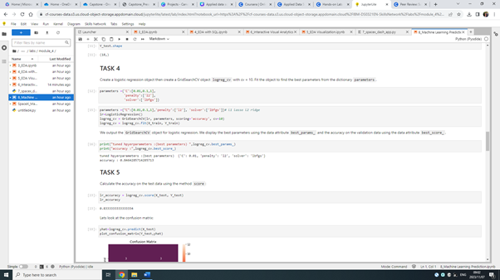
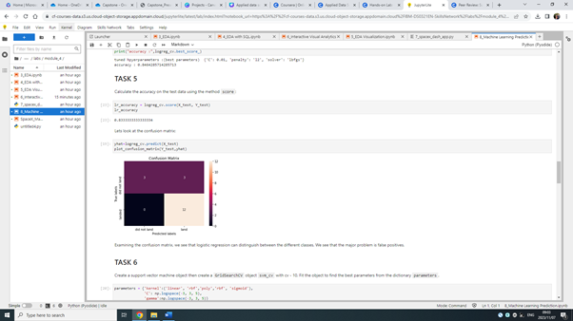
Results
Predictive analyses

Slide 22
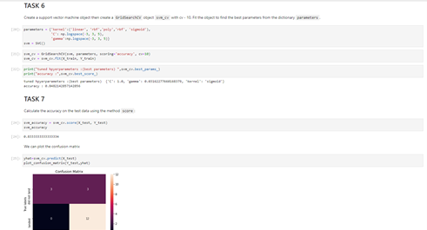
Results
Predictive analyses

Slide 23
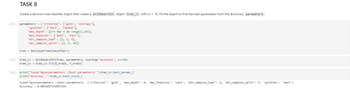
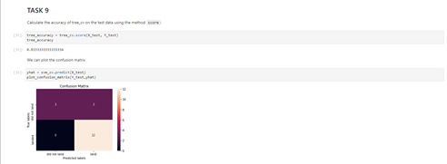
Results
Predictive analyses

Slide 24
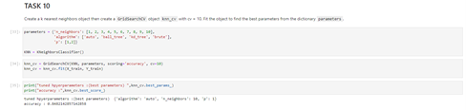
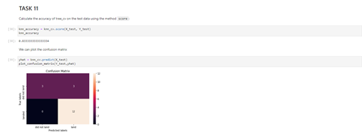
Results
Predictive analyses

Slide 25
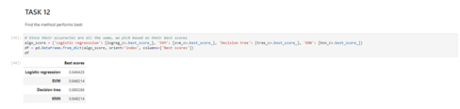
Results
Predictive analyses

Slide 26



Conclusion
Based on collected and wrangled data, we conclude that booster version F9 B5 B1048 - B1060 are the best booster versions for successful landing. Booster version F9 v1.1 B1012 and F9 v1.1 B1015 resulted in landing failures on drone ships. A greater success rate was observed ES-L1, SSo, HEO, and GEO. From the year 2013, significant improvements in success landing rates were observed. However, in 2017, a dip in success rates was observed.

